Slide 1
ThyRAD
Thyroid Radioactive Decay Prediction Tool
Quick Start User Guide
ThyRAD v0.63
P 01

Slide 2
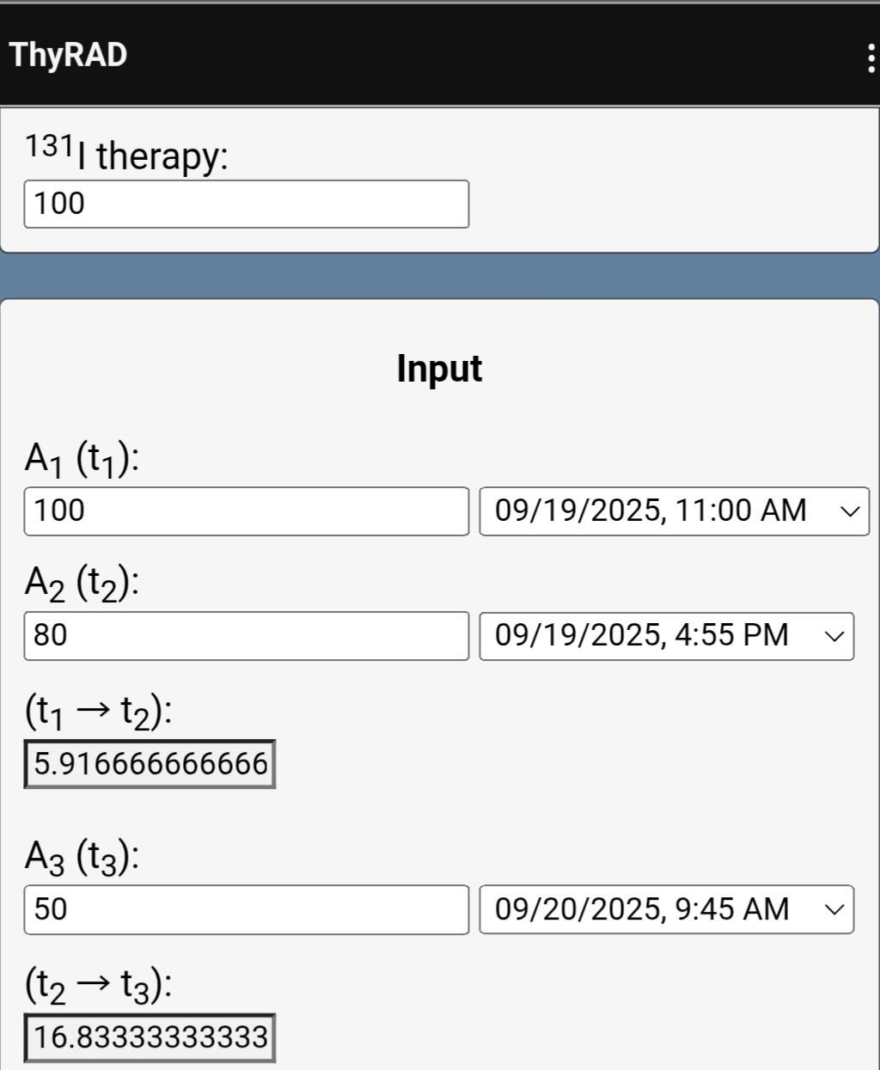
131I Therapy Reference value for the decay model. This value may correspond to the activity to be administered for patient therapy (e.g. 100 mCi).
In our validation study, measurements were performed on a phantom using a hand-held survey meter, aligned with the source at approximately 1 meter. This field is intended for modeling purposes only.
A₁ (t₁) — Set the recorded value observed at time t₁ (e.g. 100 µSv/h).
A₂ (t₂) — Set the second measurement recorded at time t₂ using the same geometry, distance, and instrument settings as A₁(t₁), e.g. 80 µSv/h.
(t₁ → t₂) — The interval between the first and the second measurement, is automatically computed (e.g. 5.91 hours).
A₃ (t₃) — Set the third measurement recorded at time t₃ using the same geometry, distance, and instrument settings as A₂(t₂) and A₁(t₁), e.g. 50 µSv/h.
(t₂ → t₃) — The interval between the second and the third measurement, is automatically computed (e.g. 50 hours).
ThyRAD v0.63
P 02

Slide 3
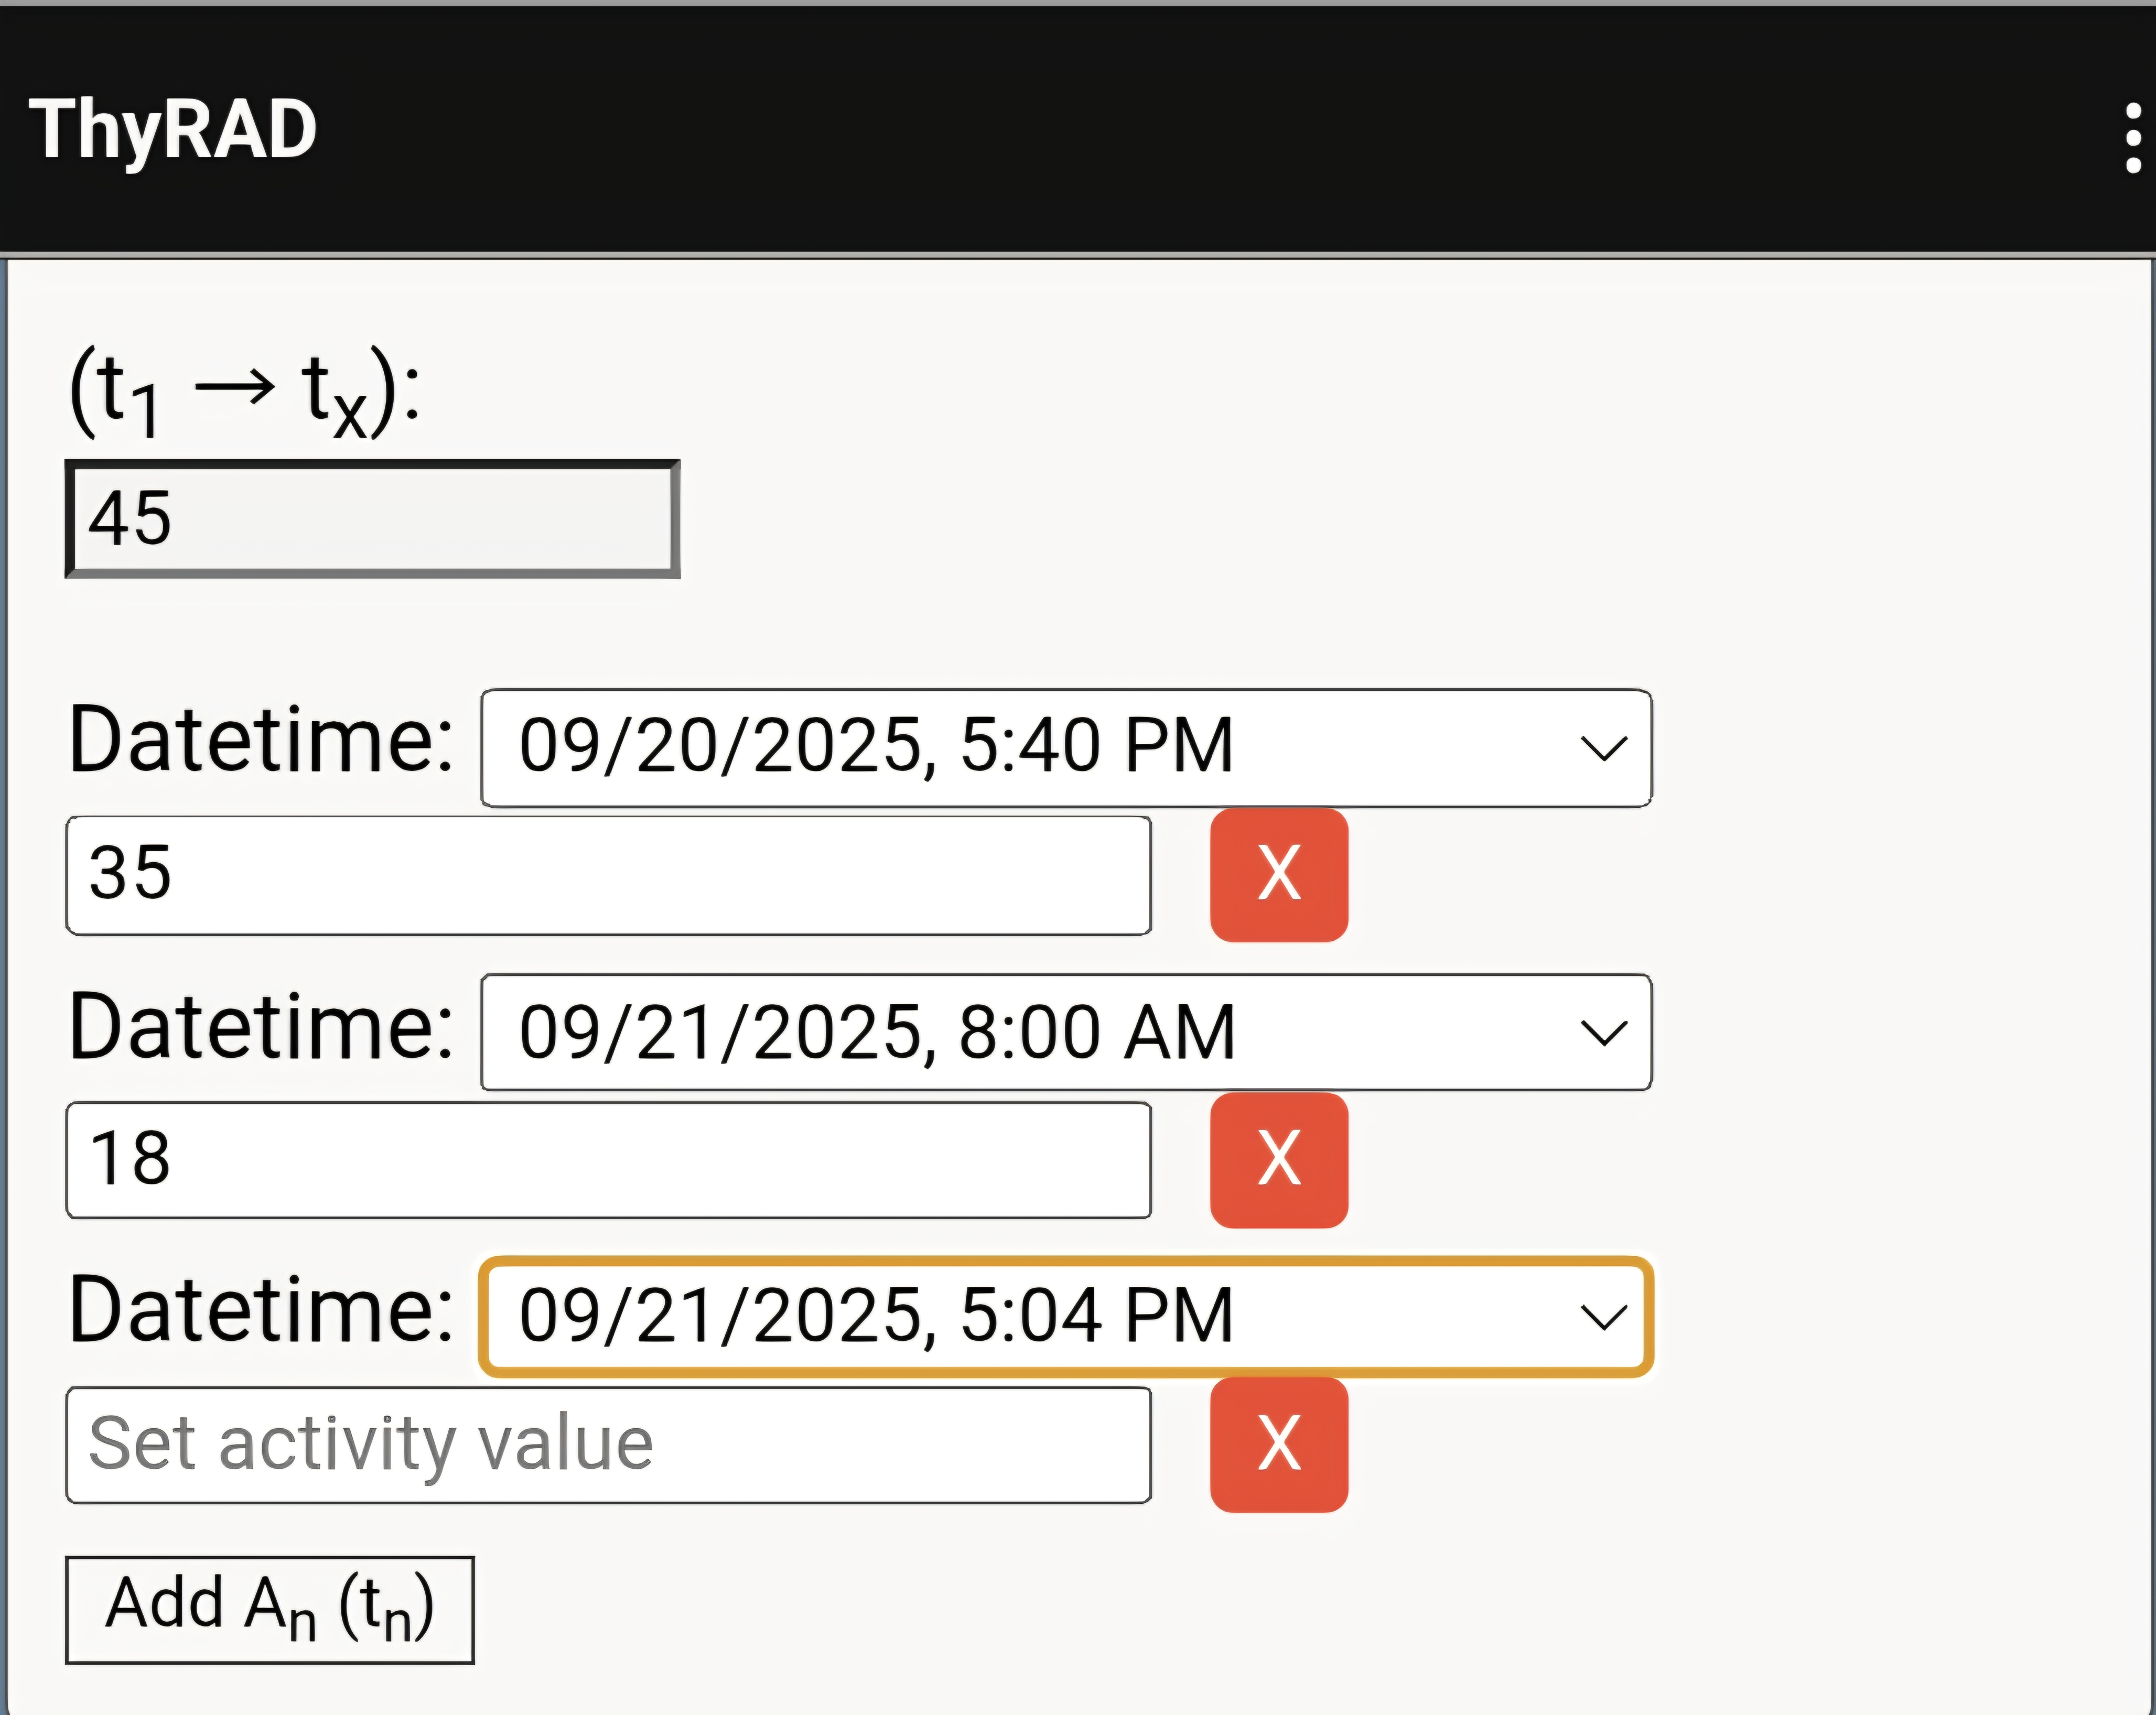
(t₁ → tₓ): — The interval between the first and the last measurement, is automatically computed (e.g. 45 hours between the first and the last measurement).
Add Aₙ(tₙ) — Subsequent measurements recorded at time tₙ (after the third). It's possible to add as many measurements as needed and each additional value (recording using the same geometry, distance, and instrument settings as the previous ones) will be included in the multi-segmented evaluation
(e.g.: the next fourth and fifth measurements were performed at 5:40 PM on September 20, 2025 (35 µSv/h) and at 8:00 AM on September 21, 2025 (18 µSv/h).
ThyRAD v0.63
P 03

Slide 4
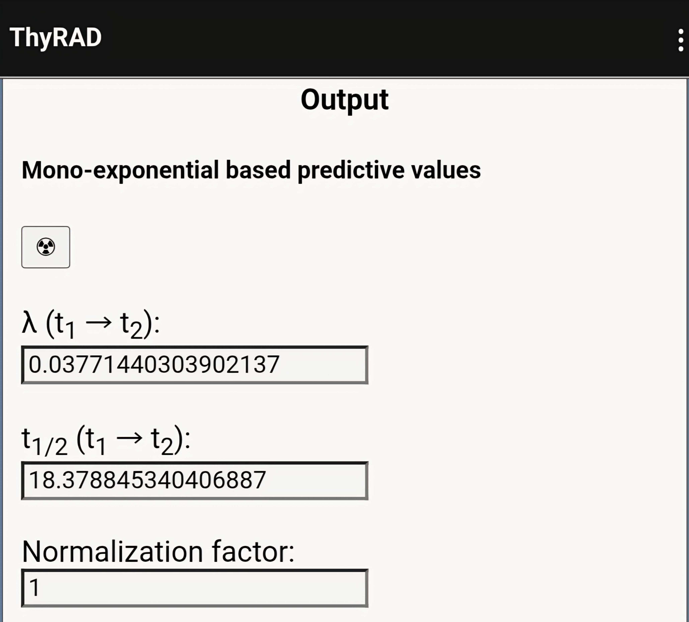
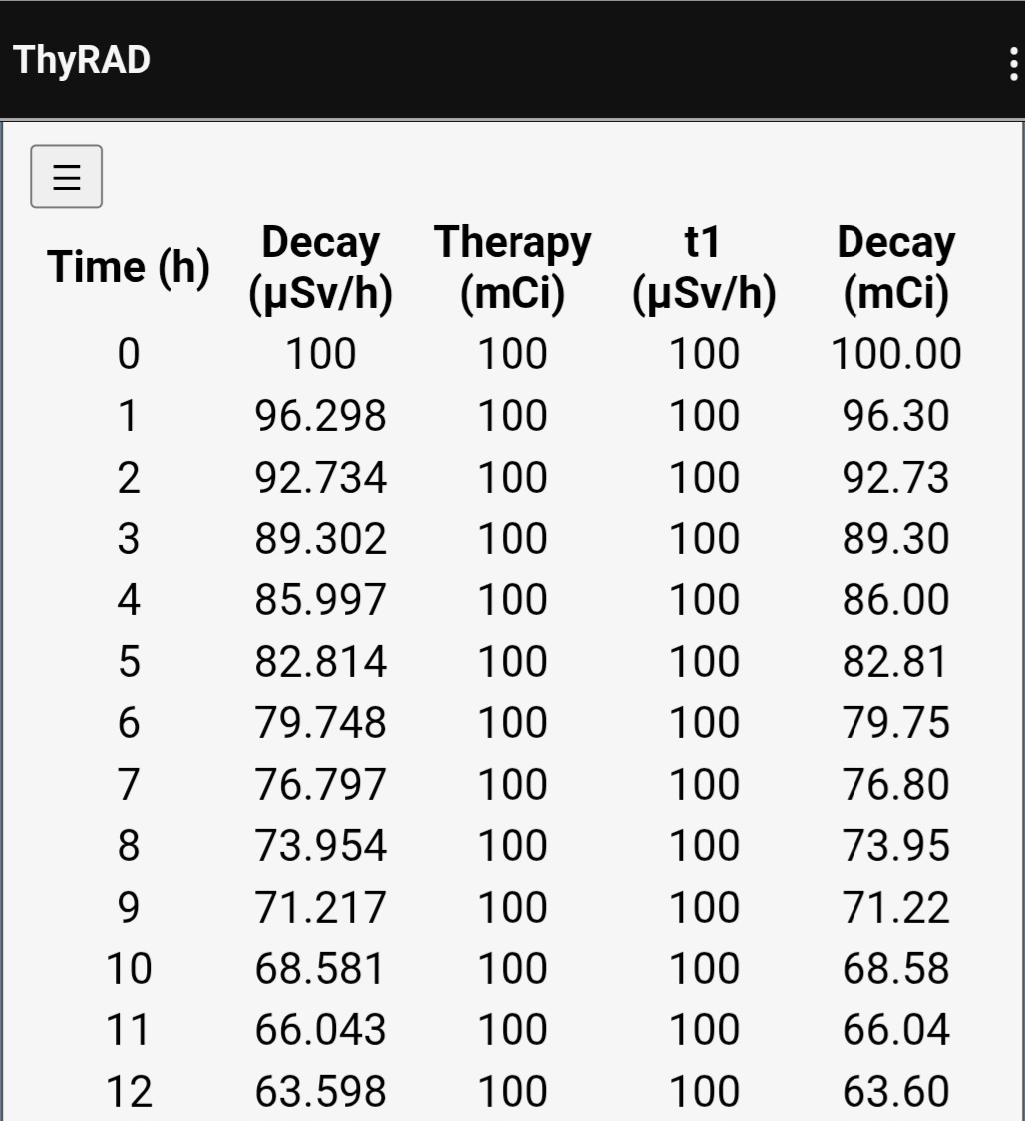
λ (t₁ → t₂) and t½ (t₁ → t₂) — Automatically computed from A₁(t₁) and A₂(t₂) using the mono-exponential fit:
λ = ln (A₁/A₂) / (t₂ − t₁); t½ (hours) = ln(2) / λ.
The app reads the exact timestamps and uses the measurement units you entered. Results appear in this output panel; editing either measurement or its time updates the values automatically.
Normalization factor — Unitless multiplier applied to the half-life estimated over (t₁ → t₂). The default is 1 (same slope after t₂). Values >1 slow down the decay; values <1 speed it up. Updating this field refreshes the Output and the predicted decay table/curve . This factor can be adjusted manually to explore research scenarios.
Decay Table (t₁ → tₓ) — Auto-populated hour by hour. Each row contains: Time (hours since t₁), Decay (expressed as µSv/h) predicted at the corresponding hour), Therapy (expressed in mCi), t₁ reference activity (expressed as µSv/h), and Decay (expressed in mCi) which is the retained activity at each time point computed by multiplying the predicted Decay (µSv/h) by the selected Therapy (mCi) and dividing by the initial rate t₁ (µSv/h).
ThyRAD v0.63
P 04

Slide 5
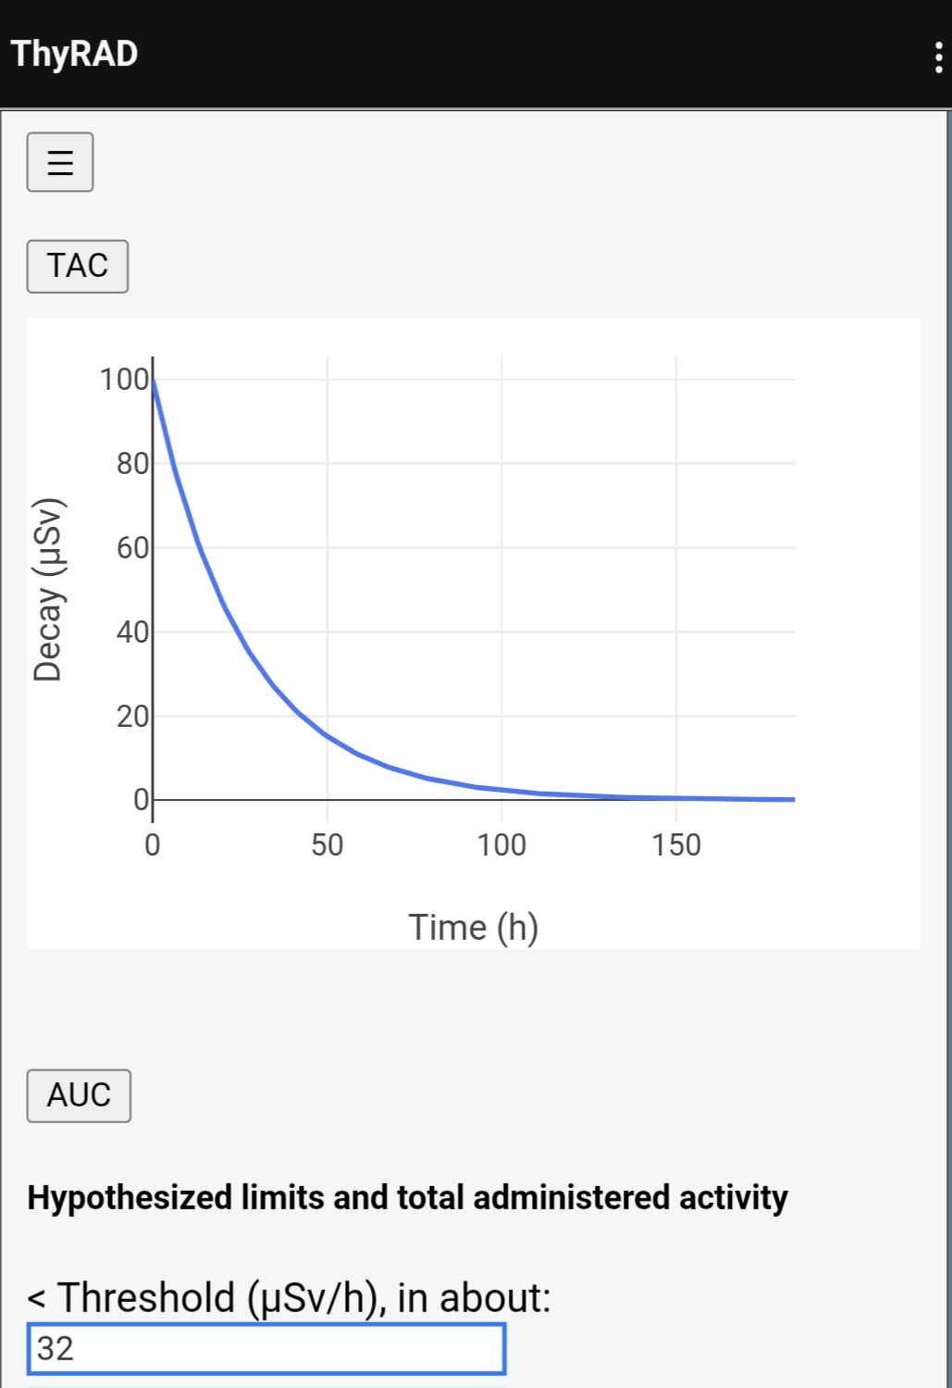
TAC (Time Activity Curve) — The time axis is in hours since t₁; the vertical axis is the predicted rate (µSv/h) at the reference geometry.
Updating inputs refresh the curve and its values up to tₓ.
AUC (Area Under Curve) — The time axis is in hours since t₁; the vertical axis is the predicted rate (µSv/h) at the reference geometry.
Updating inputs refresh the curve and its values up to tₓ.
< Threshold (µSv/h), in about: — Estimated time for the predicted rate to fall below the selected threshold. By default, the threshold is set to limit of 30 µSv/h. The value updates automatically when inputs or the normalization factor change and can be verified on the decay table.
In this example, the 30 µSv/h threshold is reached in about 32 hours from the first measurement A₁(t₁).
ThyRAD v0.63
P 05

Slide 6
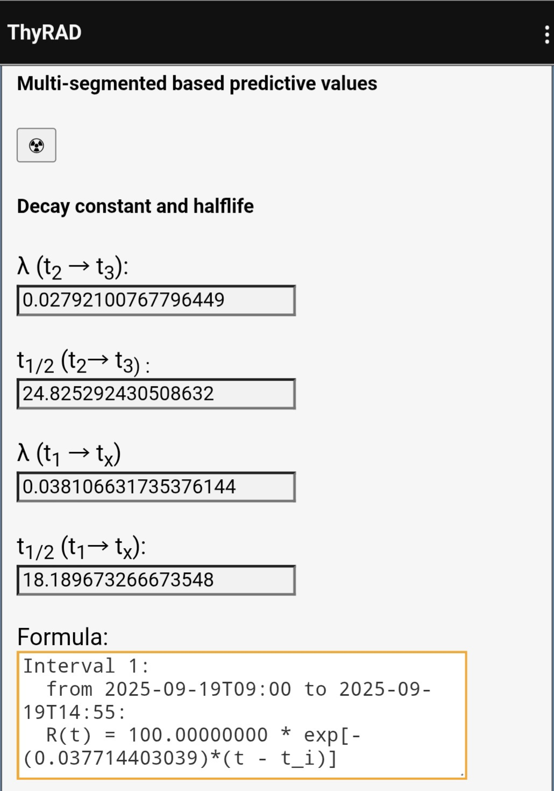
λ (t₂ → t₃) — Automatically computed from A₂(t₂) and A₃(t₃), if the third measurement is available; updates when either value or timestamp changes.
t½ (t₂ → t₃) — Half-life derived from λ(t₂→t₃) as t½ = ln(2)/λ; reported in hours.
λ (t₁ → tₓ) — Effective decay constant used for the overall model up to tₓ; for the post-t₂ segment it is obtained from the current t½(t₂→tₓ) via λ = ln(2)/t½.
t½ (t₁ → tₓ) — Effective half-life for the overall time span up to tₓ.
FORMULA: — Multi-segmented based predictive values
Shows the analytic expression of the piecewise (multi-segment) decay curve built from your measurements. When ≥3 points are available, the tool estimates one decay rate for each interval between consecutive times and defines a continuous function segment by segment: on [tᵢ, tᵢ₊₁) the model follows a mono-exponential with the rate derived from Aᵢ(tᵢ) and Aᵢ₊₁(tᵢ₊₁). The panel lists these interval-specific formulas and their time ranges, so you can see exactly which law is applied where; it updates automatically as you add or edit measurements
ThyRAD v0.63
P 06

Slide 7
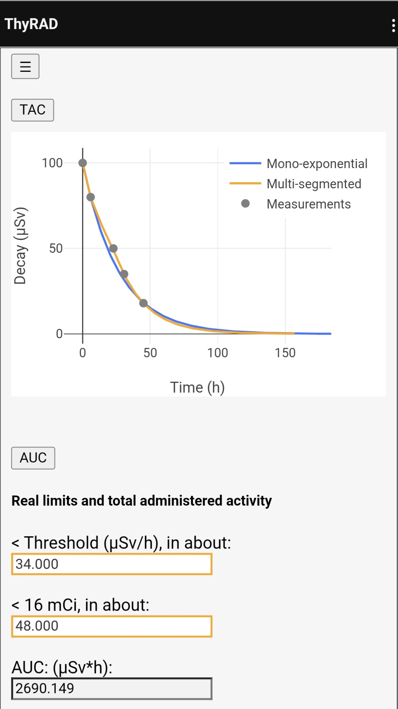
TAC (Time-Activity Curve) — Displays both curves: the mono-exponential fit (from A ₁– A₂) and the data-driven multi-segment model (≥ 3 points) overlaid with the measured points.
Time is in hours since t₁; vertical axis is the predicted rate (µSv/h) at the reference geometry. Updating inputs refreshes both curves up to tₓ.
< Threshold (µSv/h), in about: — Estimated time for the multi-segment curve to drop below the selected threshold (default 30 µSv/h). The value updates automatically and can be cross-checked on the decay table.
< 16 mCi, in about: — Estimated time for retained activity to fall below 16 mCi based on the multi-segment model (may differ from the mono-exponential estimate). Updates when inputs change.
AUC (Area Under Curve) — Integral of the displayed curve (µSv·h) over the shown time window. Reported for the multi-segment model and useful to compare against the mono-exponential trend; it updates when inputs change.
ThyRAD v0.63
P 07

Slide 8
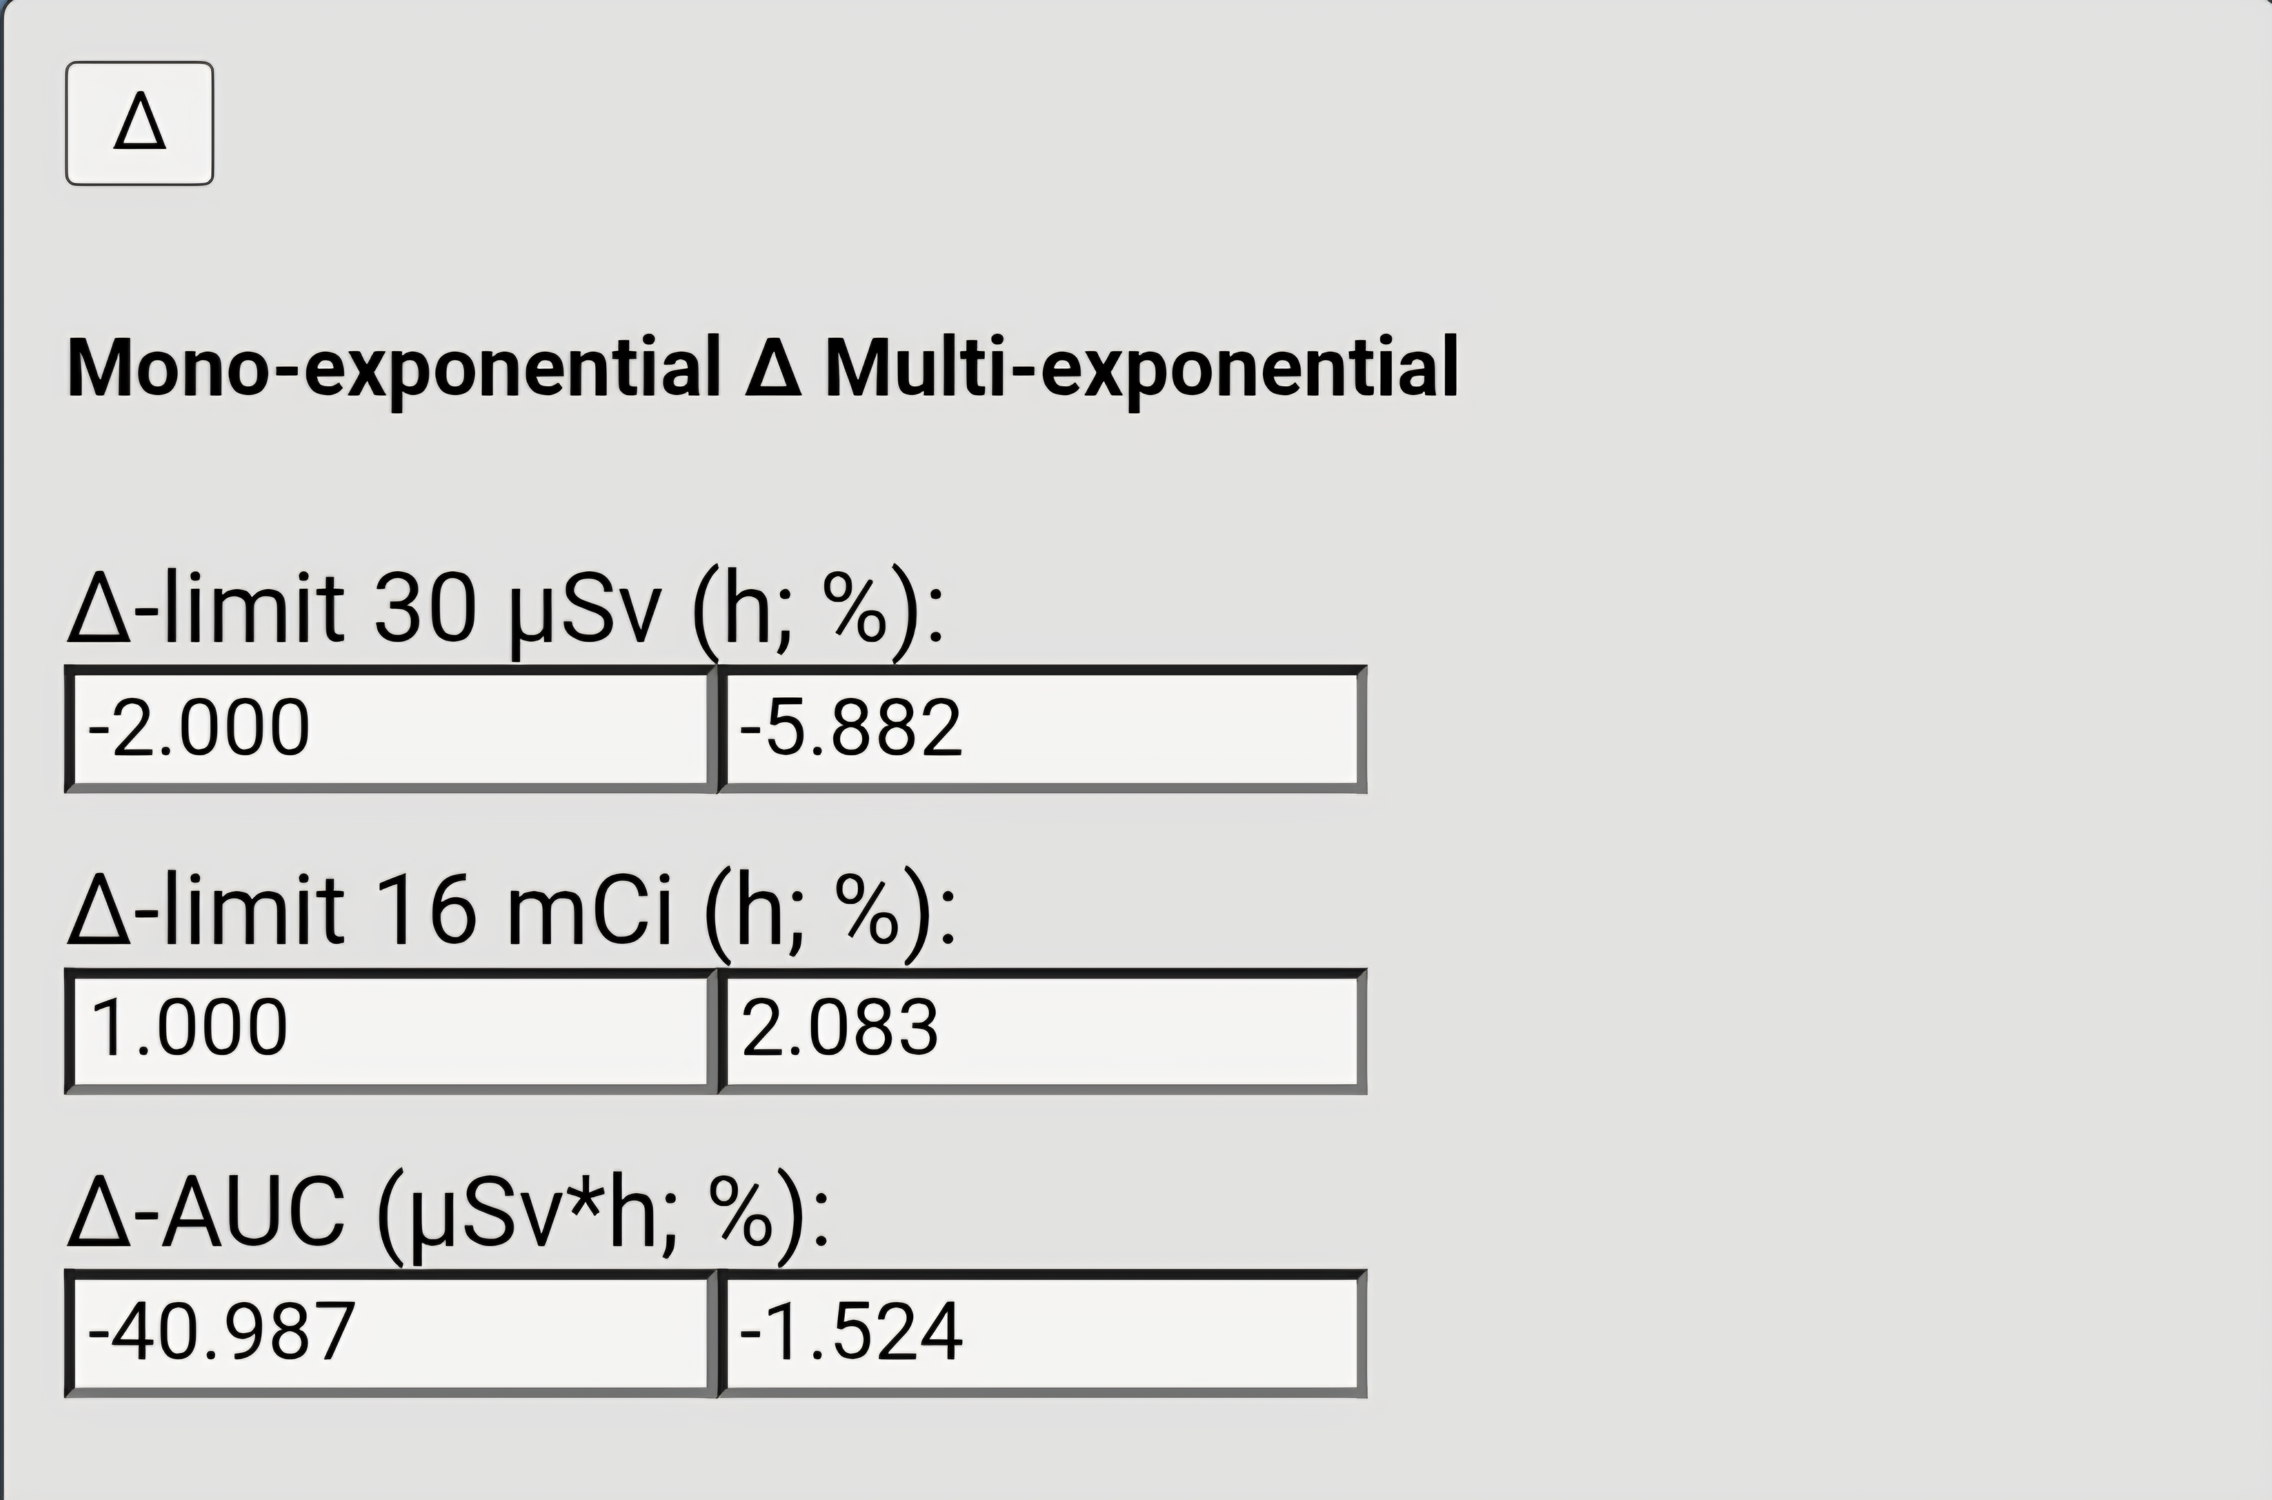
Δ limit 30 µSv/h (h; %): — Difference between the multi-segment and the mono-exponential time-to-threshold (30 µSv/h). Reported as hours and as percent relative to the mono-exponential estimate (positive = multi-segment later; negative = earlier).
Δ limit 16 mCi (h; %): — Difference between the multi-segment and the mono-exponential time to drop below 16 mCi. Reported in hours and as percent relative to the mono-exponential estimate.
Δ AUC (µSv·h; %): — Difference between the multi-segment and the mono-exponential Area Under Curve over the shown window. Reported as absolute AUC and as percent relative to the mono-exponential AUC (positive = multi-segment higher; negative = lower).
ThyRAD v0.63
P 08

Slide 9
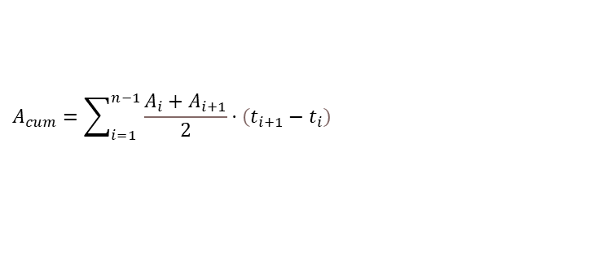
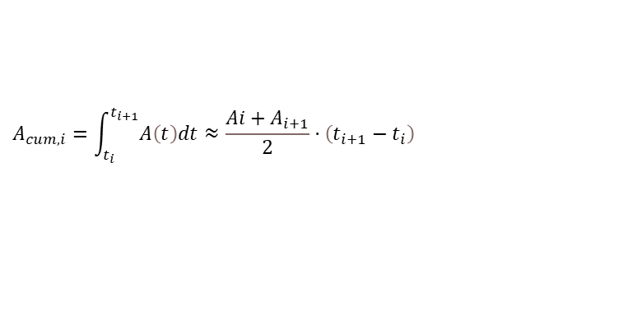
Computation Reference — Formulas
$$A_{cum,i}=\int_{t_{i}}^{t_{i+1}}{A\left(t\right)dt}≈\frac{Ai+A_{i+1}}{2}⋅\left(t_{i+1}−t_{i}\right)$$
$$A_{cum}=\sum_{i=1}^{n−1}{\frac{A_{i}+A_{i+1}}{2}}⋅\left(t_{i+1}−t_{i}\right)$$
ThyRAD v0.63
P 09

